Slide 1

Jordan University of Science and Technology Faculty of Science & Art Department of Biotechnology & Genetic Engineering
Introduction to genetics LAB
Semester: Fall 2022/2023
Course: Molecular Genetics Laboratory (B344)
Instructor: Adan Alnaamneh

Slide 2
content
Important definitions in genetics
Mendelian laws of inheritance
Instruments in our LAB

Slide 3

Definitions
Genetics: The science that studies the mode of genetic material transmission from one generation to another.
Gene: A unit of hereditary information consisting of a particular sequence of nucleotides of DNA that determines a certain phenotypic trait either directly or indirectly.
Genotype: Genetic makeup of an organism.
Phenotype: The traits of an organism that are expressed.

Slide 4

Definitions
Homologous chromosomes: Chromosomes that occur in pairs and are similar in their morphology (length, centromere position, banding pattern). Each member of the pair originates from one of the parents. They contain the same gene loci and segregate during meiosis.
Autosome: any chromosome other than sex chromosomes that is not involved in sex determination. It occurs in pairs in somatic cells and singly in gametes.
Somatic cell: any biological cell forming the body of an organism.

Slide 5
Definitions
Homozygous: the state of an organism possessing two identical alleles on one or more loci.
Heterozygous: the state of an organism possessing different alleles at one or more loci.
Hemizygous: the state of an organism possessing only one allele (usually on sex chromosomes).

Slide 6
Definitions
Haploid (1n): a cell having one set of chromosomes only (e.g: human gametes).
Diploid (2n): a cell having two sets of chromosomes (e.g.: human somatic cells).
Codominance: when both alleles of a pair are fully expressed in the heterozygous state.
Semidominance (incomplete dominance): intermediate between the dominant and recessive alleles (phenotypic ratio is 1:2:1 instead of 3:1).

Slide 7
Definitions
Allele: one of the alternative forms of a gene occupying a corresponding locus on homologous chromosomes.
Dominant allele: an allele that can express itself over the other allele.
Recessive allele: an allele that lacks the ability to express itself when the dominant is present
Wild type: an individual having the normal phenotype (i.e.: the most common phenotype).
Mutant or variant: an individual having a phenotype that differs from the normal phenotype.

Slide 8
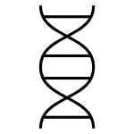
Mendelian laws of inheritence
Law 1: Law of Segregation
Alleles in diploid individuals separate during the process of gamete formation (meiosis).
Law 2: Law of Independent Assortment
Each member of a pair of homologous chromosomes separates independently of the members of other pairs so the results are random.
Law 3: Law of Dominance
A heterozygous individual will express the phenotypic characteristics of the dominant allele.

Slide 9
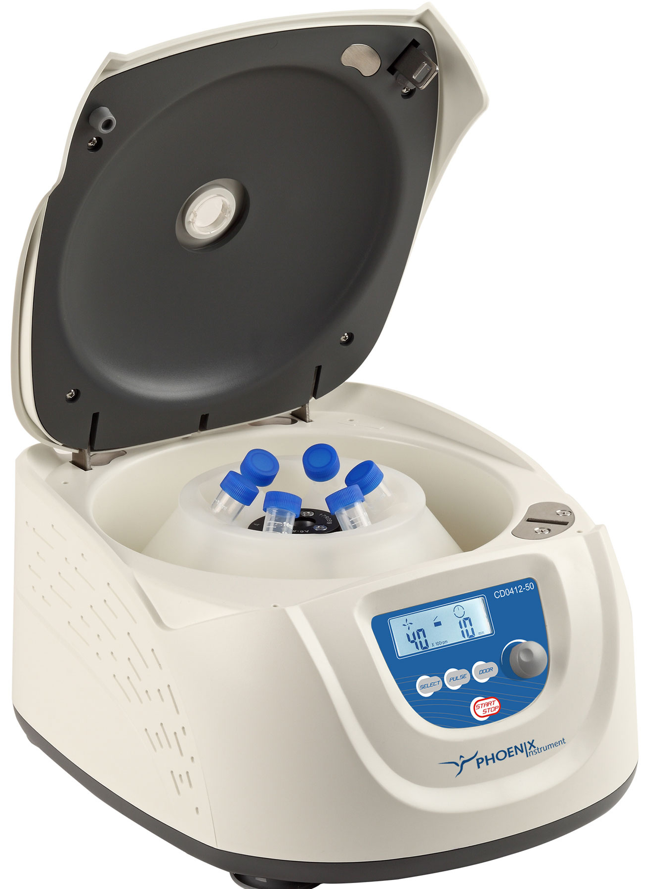
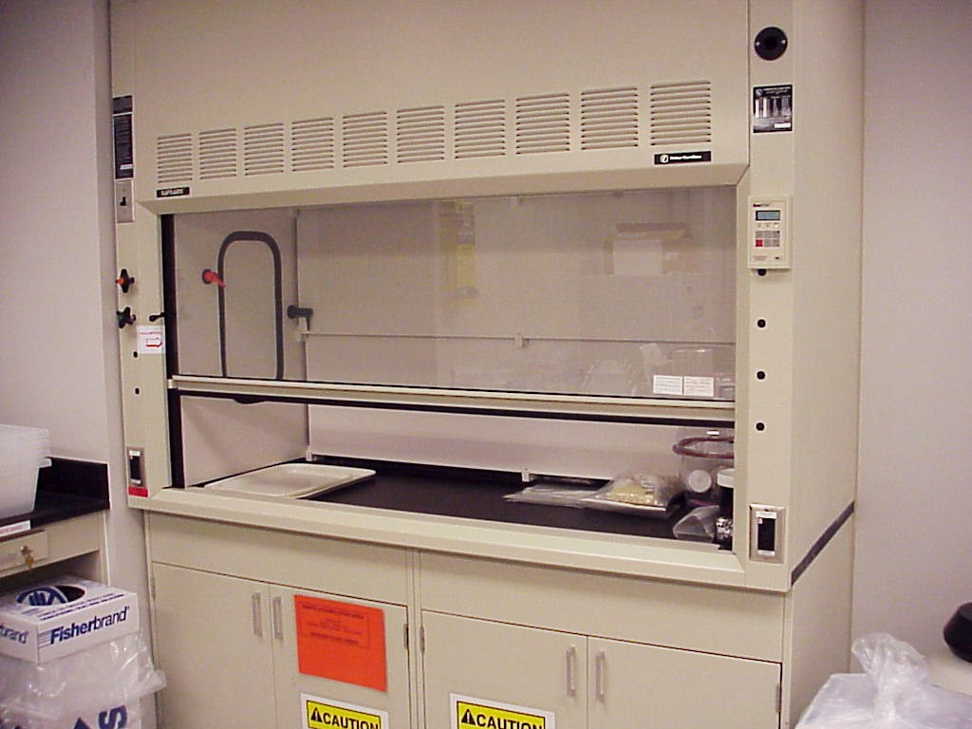
Instruments
centrifuge
Fume hood

Slide 10
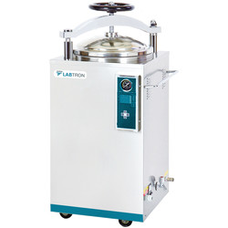
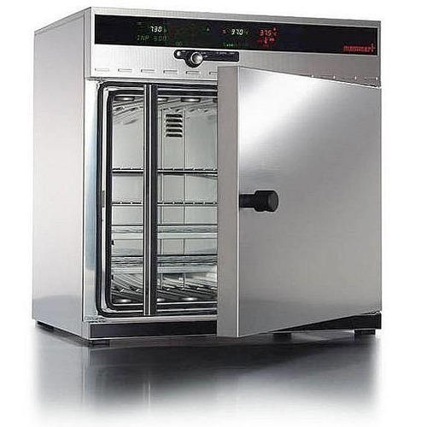
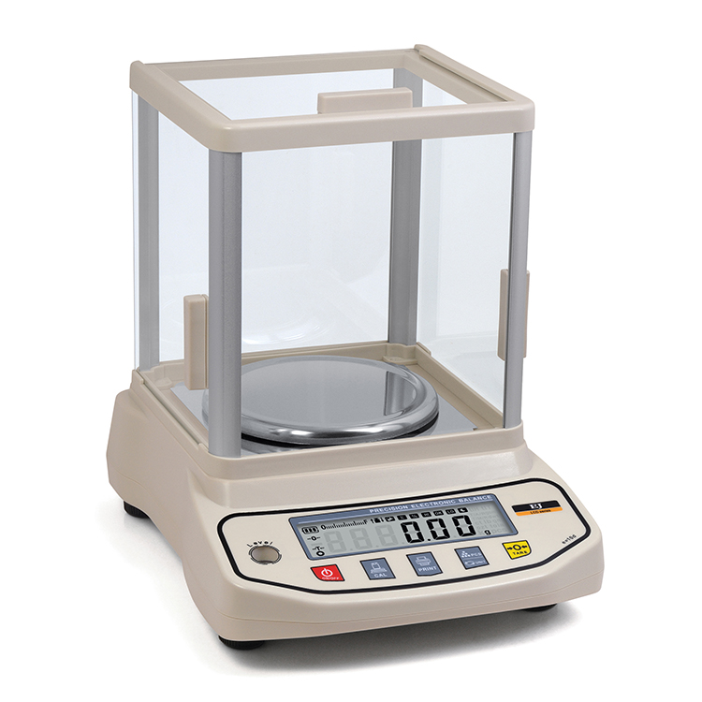
Instruments
Autoclave
Incubator
Balancer

Slide 11

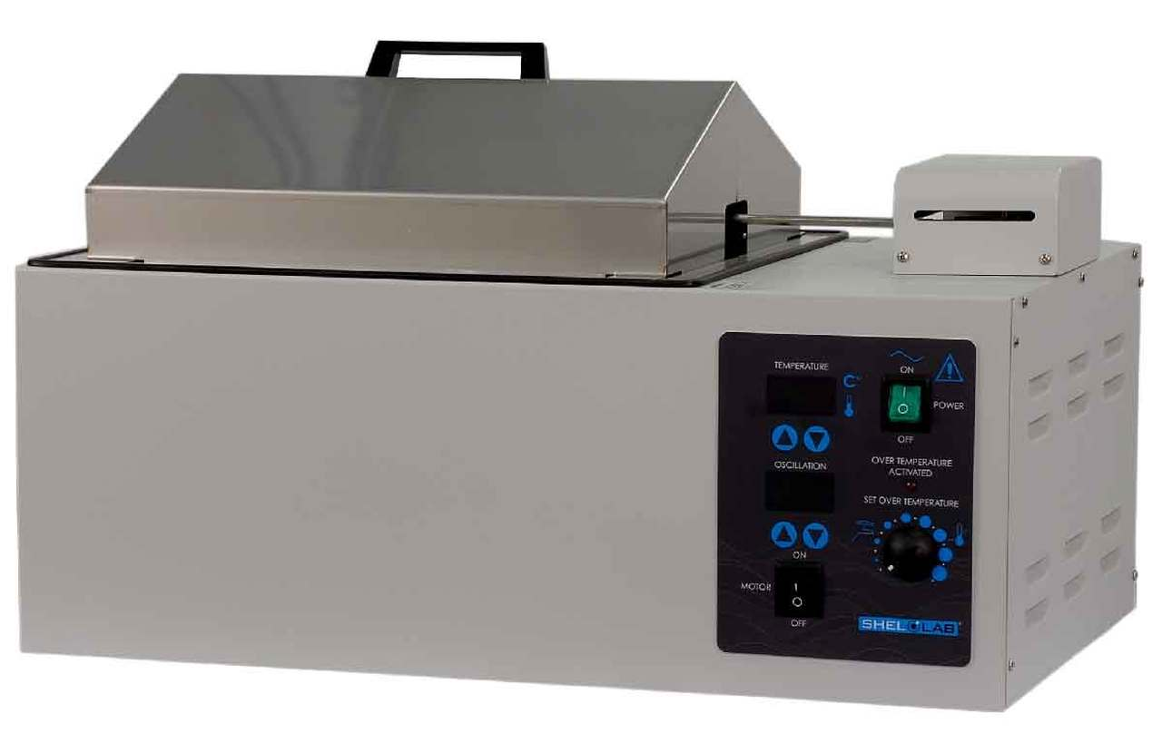
Instruments
vortex
Water bath

Slide 12
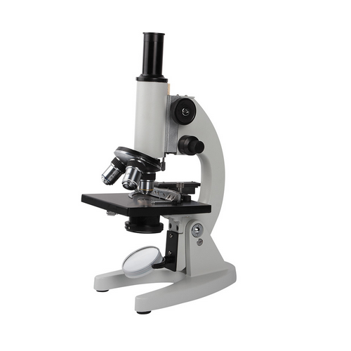
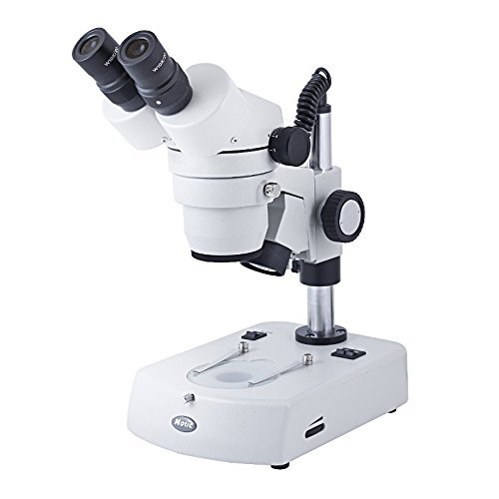
Instruments
Compound microscope
Dissecting microscope

